Slide 1
RoboReviews
The new product review aggregator
Aleksa, Cristina, Kira, and Ramzi

Slide 2
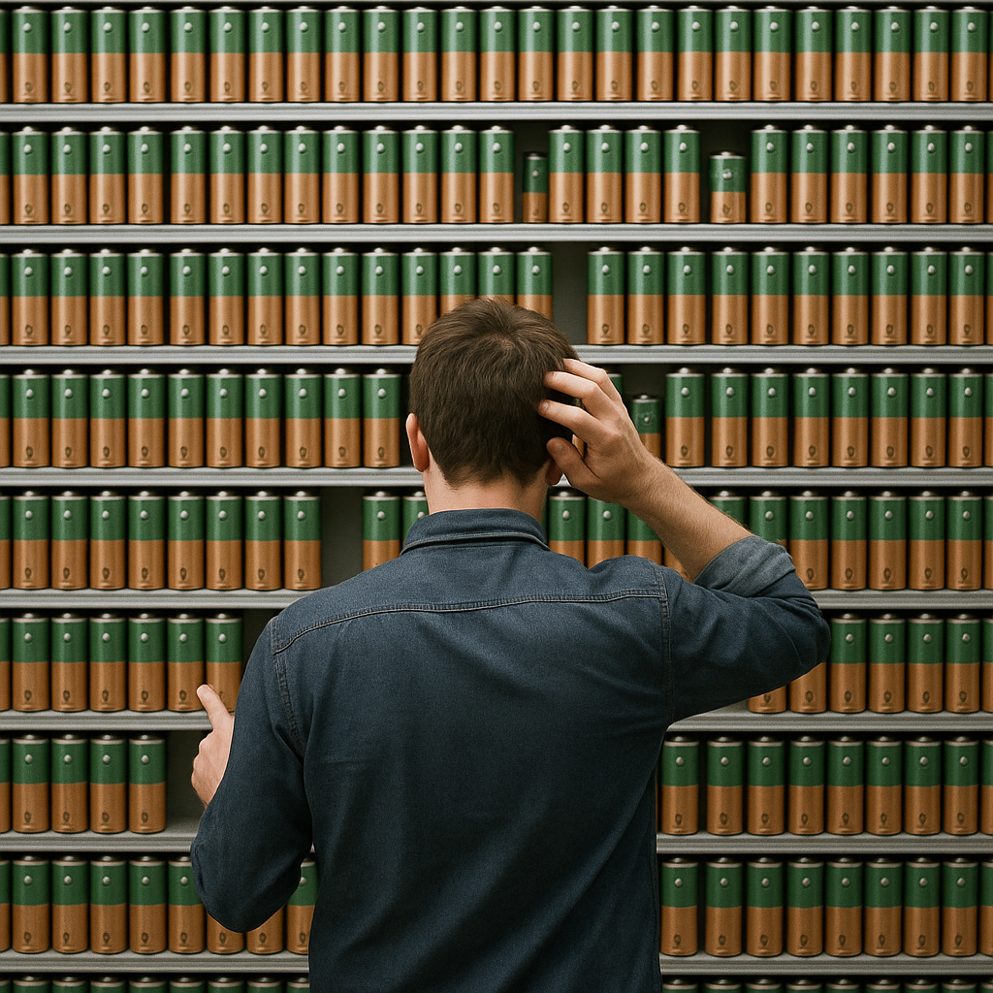
“The pitch”
“Choosing the right battery becomes simple when real user experiences are transformed into clear insights.”
RoboReviews is an NLP-driven product review platform that transforms raw customer feedback into structured insights.
It collects reviews, assigns sentiment labels, groups products into six final categories, and generates a summary of the top products in each group.

Slide 3
Introduction
Problem Statement:
With thousands of scattered reviews that are hard to process manually, not only for companies but also consumers, our system automates the entire process so consumers can quickly access clear, trustworthy insights to make better buying decisions.
3-step pipeline
Sentiment Classification (Twitter RoBERTa Sentiment Model): Reviews are labeled as positive, neutral, or negative.
→ We want to measure overall customer satisfaction to identify the top- and worst-performing products.
Product Clustering & Top-3 Selection ( GPT-4o Mini): Reviews are grouped into broader product categories and the top products are selected.
→ We want to compare similar items to produce meaningful product rankings.
Generative Summarization (Llama mini): A language model creates concise summaries for each product.
→ The quality depends on clean preprocessing, accurate sentiment signals, and strong category clusters.
Notes:
Explain the real world problem this solves
Tell me how the models fit together into a single coherent application
How does the design of one models affect the other?
Introduce your methodology, just a sentence.
Now that you have seen our super cool product and know why this matters, let me show how we did it!

Slide 4
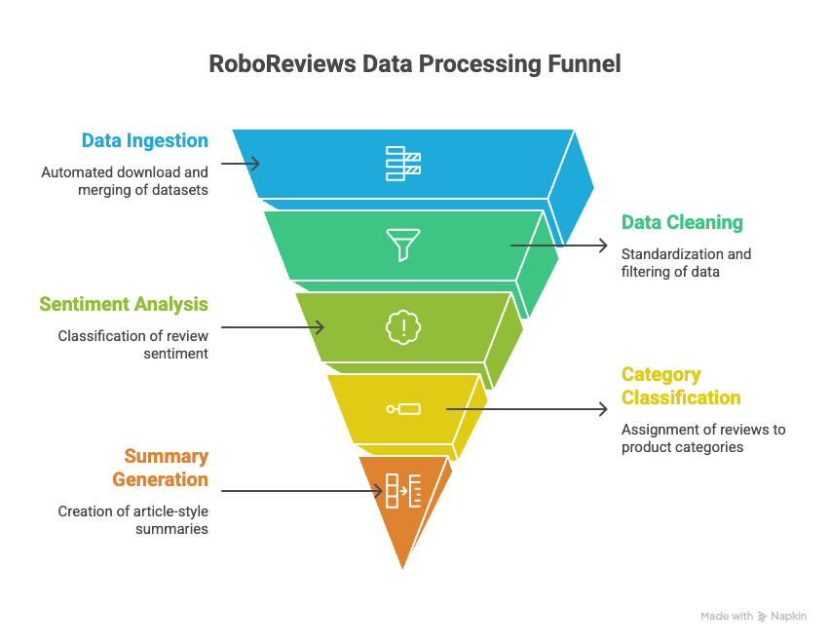
Methods
Primary Dataset: Consumer Reviews of Amazon Products
The project uses kagglehub to download and manage all files without manual intervention.
Cleaning included removing null values and corrupted rows, filtering, creating unique product identifiers, and using pickle caching for faster reloads.
Top 3 product evaluation criteria:
35% sentiment score
35% rating score
15% review recommendation
15% frequency
Product categories: Batteries, E readers, Kids electronics, Tablets, Streaming devices, and Smart Speakers.
Product Summary: generated from 20 most helpful reviews.

Slide 5
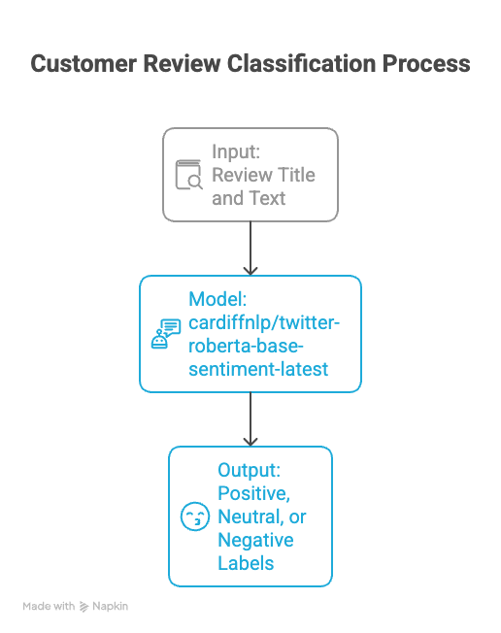
Model 1
Purpose: Classify customer reviews into positive, negative, or neutral.
model: cardiffnlp/twitter-roberta-base-sentiment-latest.
This model is optimized for sentiment analysis in short social media text.
Input: review title and full review text
Output: Positive, Neutral or Negative labels in an additional column.

Slide 6
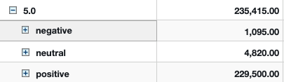
Model 1 - Evaluation
Accuracy Score: 0.92
Precision: 0.65 - macro
Recall: 0.57-macro
F1-score: 0.60 - macro

Slide 7
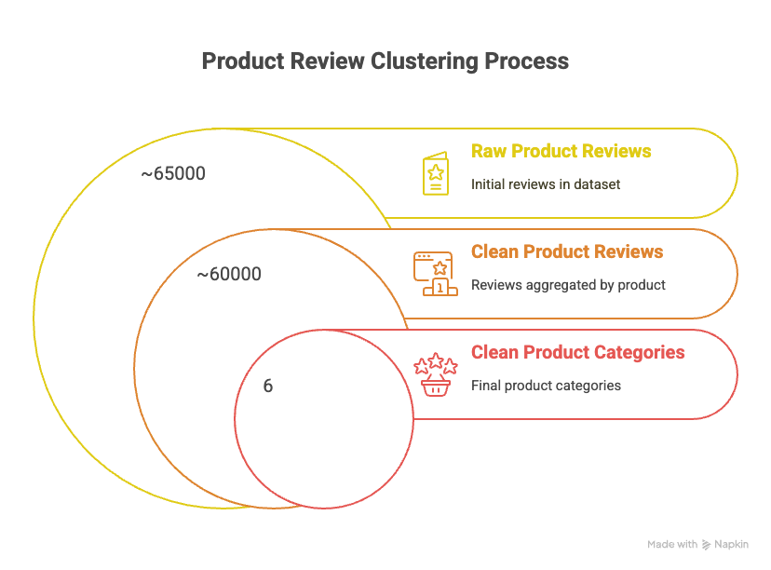
Model 2
Problem:
The dataset contains inconsistent and overly detailed product labels, so reviews for similar items are scattered across many categories—making it hard to group comparable products and identify top performers.
Purpose:
Cluster reviews into a unified structure that downstream models (top product detection + summarization) can rely on.
Input: Product name + aggregated review text
Output: Six final, clean product categories

Slide 8
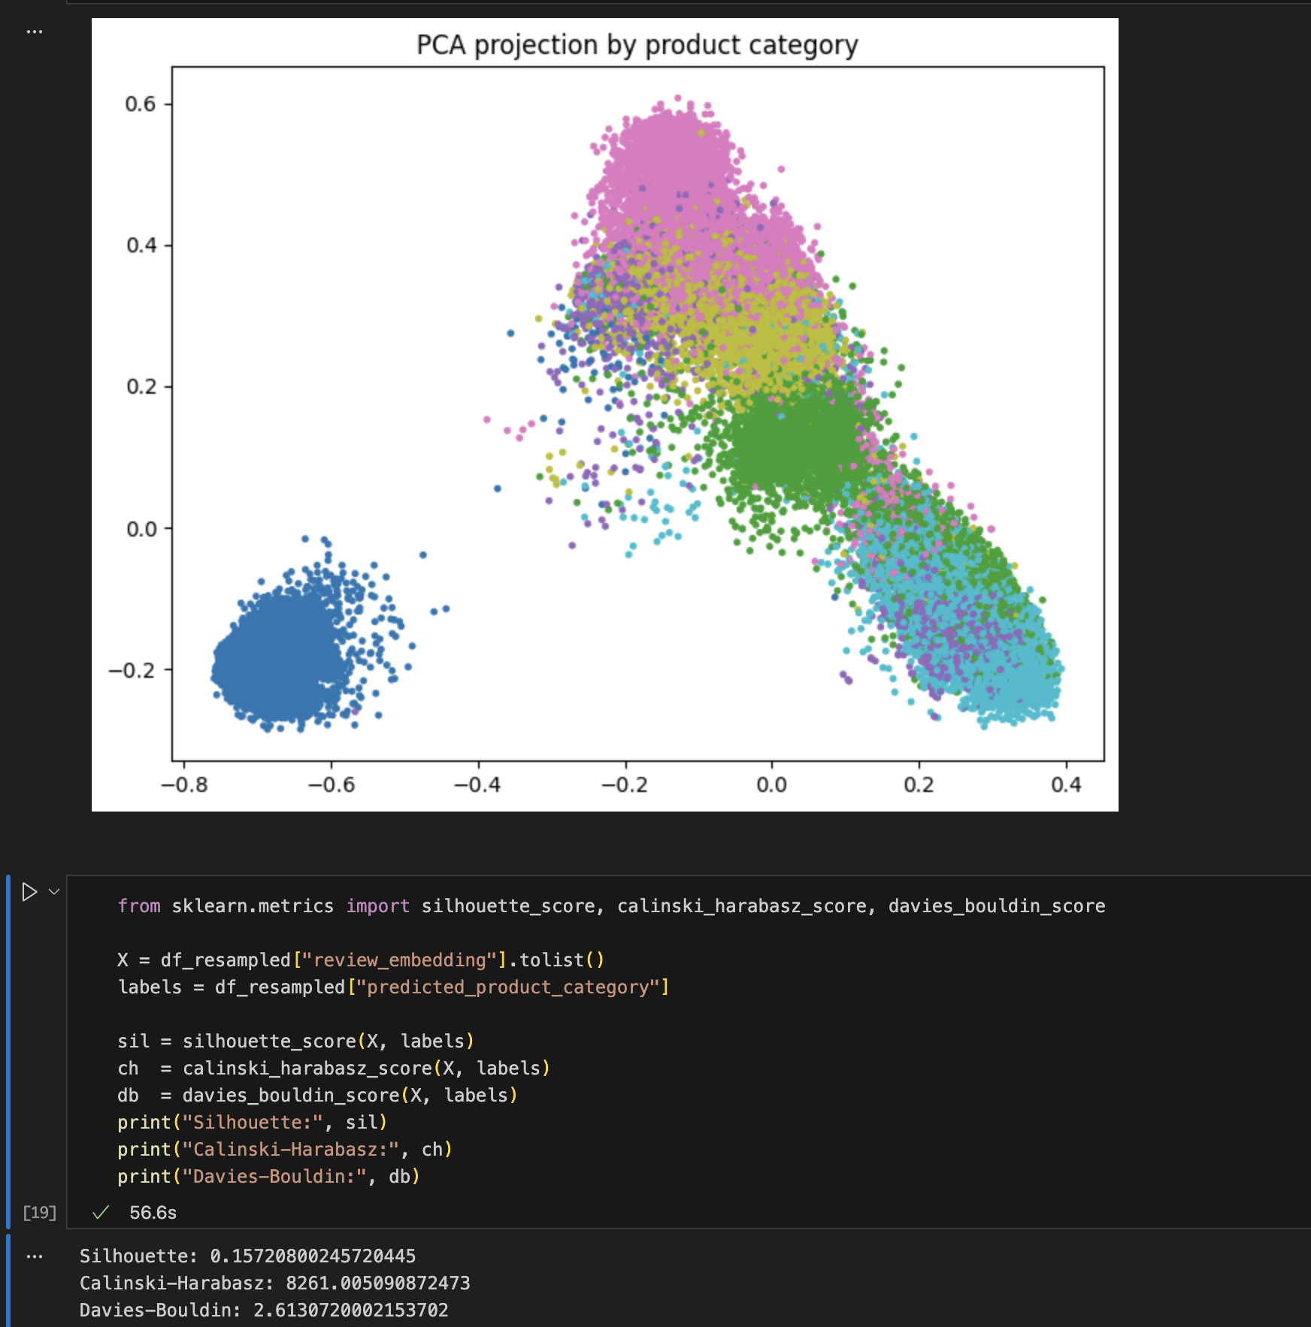
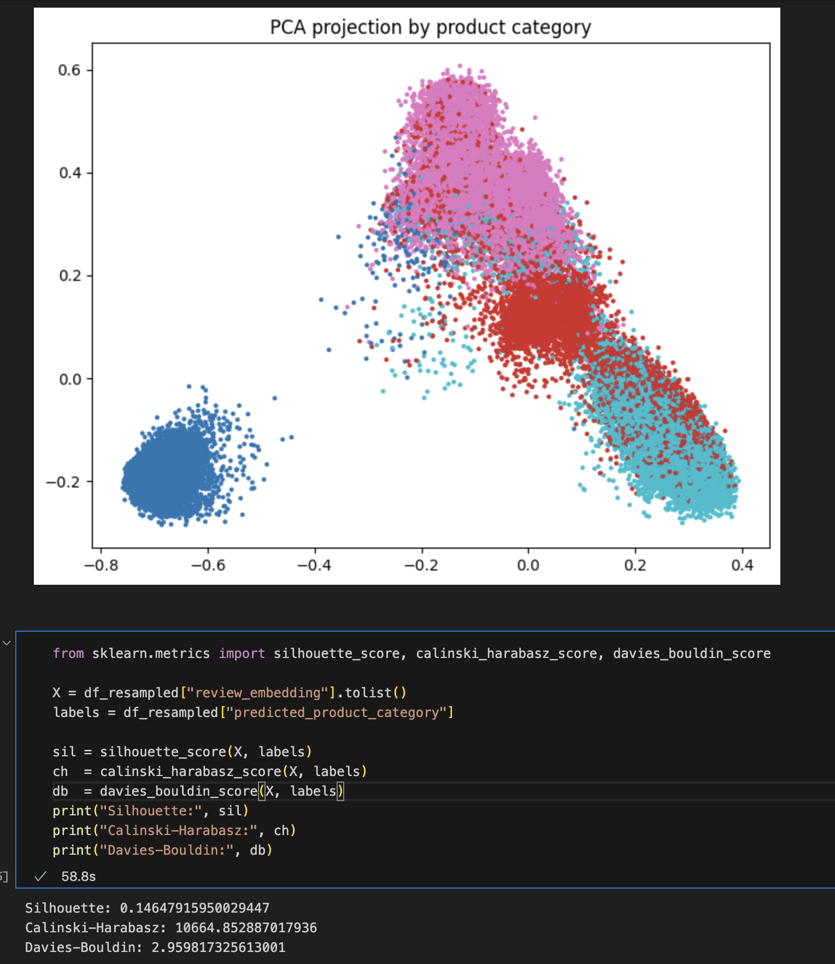
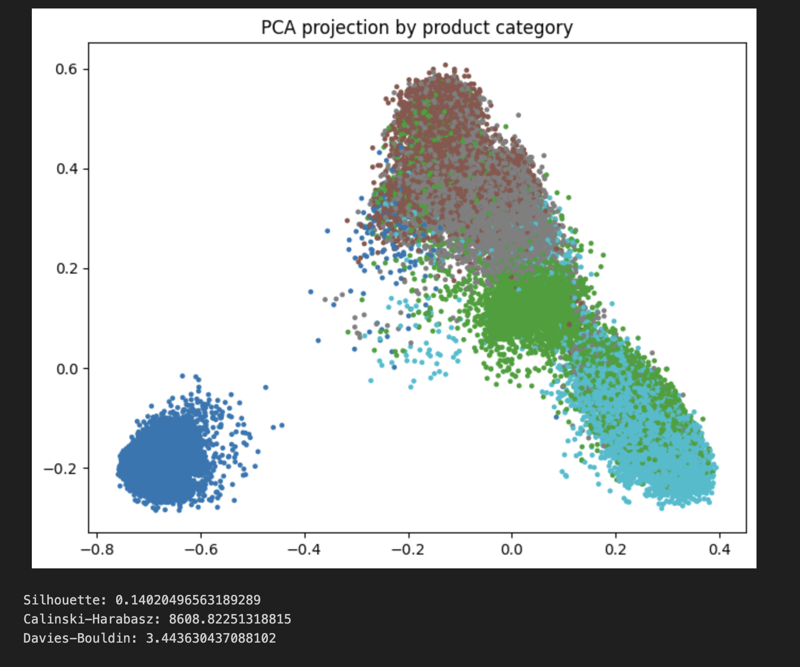
Model 2 - Evaluation
Approach: We compared multiple low-cost models but their outputs varied significantly between batches and often produced incoherent or overly narrow labels.
Method: The dataset was divided into 1,000-review batches, and each model was asked to generate categories for every slice. We then compared the outputs across batches
Evaluation:
GPT-3.5-mini: inconsistent labels between batches; categories were vague.
GPT-4o-nano: more coherent but still unstable—similar reviews produced different categories.
GPT-4o Mini: consistently generated clear, repeatable category labels across all batches.
Final tuning
We made sure that each product ID is assigned the same category (most frequent one)

Slide 9
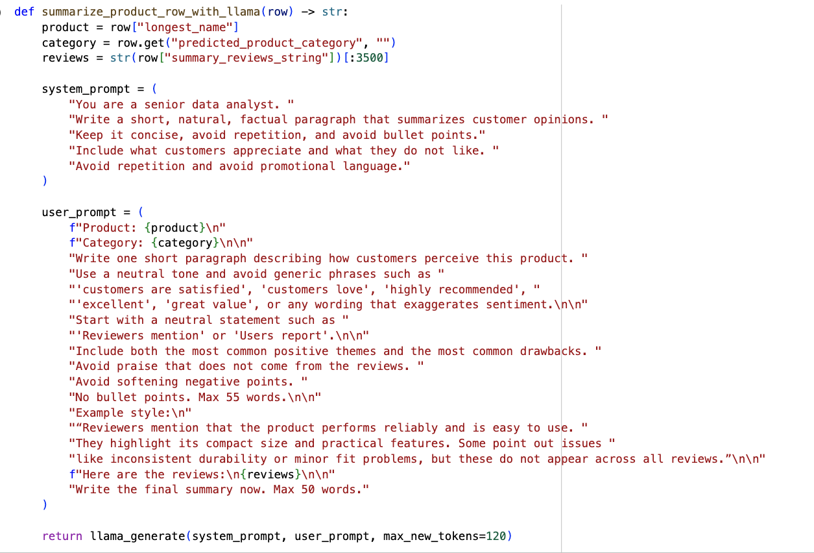
Model 3
Model: meta-llama/Llama-3.2-1B-Instruct
More human-like phrasing and a warmer tone
Prone to repetitions
Top product players evaluation criteria:
35% sentiment score
35% rating score
15% review recommendation
15% frequency
Best reviews selection:
20 most helpful reviews
Criteria based on 'reviews.numHelpful'

Slide 10
Model 3 - Evaluation
Approach:
What? Lightweight generative models
Expectation: short, factual, capturing consumer sentiment, no repetition & promotional language
How? Visual comparison of the generated summaries
Evaluation:
Mistral-small-latest: Initially produced long, repetitive summaries and required several prompt refinements; even after optimization, its outputs tended to sound more generic and less tailored to consumers.
Llama-3.2-1B-Instruct: Also needed prompt tuning to avoid repetition but ultimately generated more natural, consumer-friendly summaries with clearer reflection of actual customer opinions.

Slide 11
Takeaway
Key Takeaway: We can transform raw, unstructured data into a meaningful decision-support tool for consumers and businesses ( classification, clustering, and generative AI)
Why we deserve a medal
Instead of relying on large, expensive models, we created a fully working pipeline using cost-efficient small models (GPT-4o Mini + Llama 3.2-1B).
We enhanced the final review dataset by selecting only the top 20 most helpful reviews for each product to truly reflect what matters most to consumers.
We have applied an advanced analysis to select the best number of product categories.
We designed a custom multi-factor scoring system to identify the best and worst products.

Slide 12
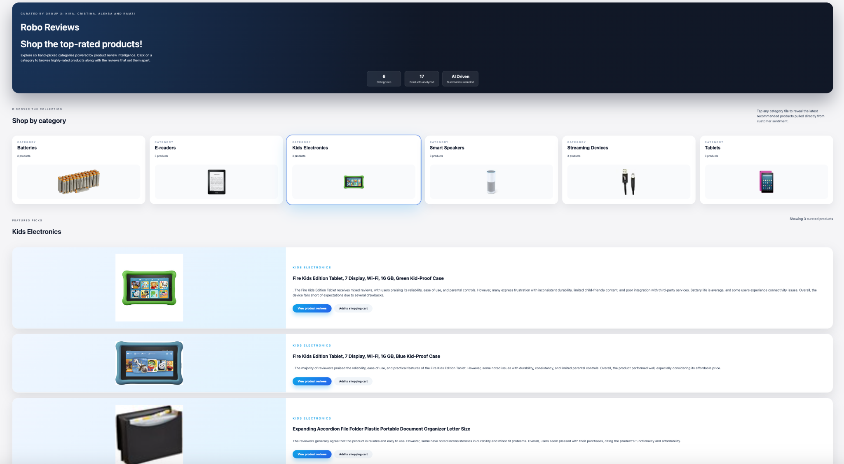
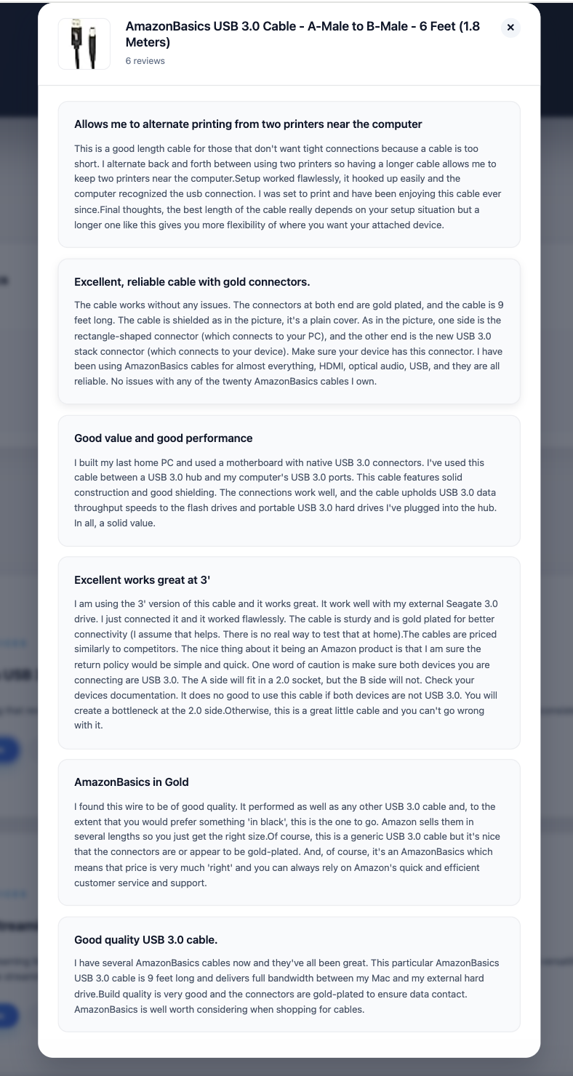
Demo
https://maleckicoa.com/demo-apps/robo-reviews
Notes:
Add a short demo of how your product can be used
At least, show the output of Model 3: textual reviews.
If you deploy, you can do: live, video, or screenshots.

